Slide 1
Cascading Style Sheets ( CSS )

Slide 2
What is CSS?
CSS stands for Cascading Style Sheets
Styles define how to display HTML elements
Styles were added to HTML 4.0 to solve a problem
External Style Sheets can save a lot of work
External Style Sheets are stored in CSS files

Slide 3
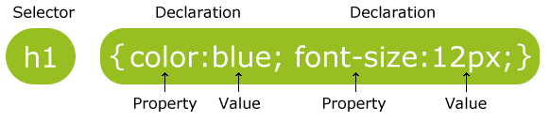
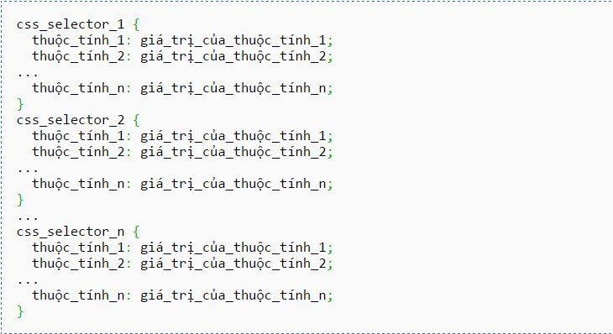
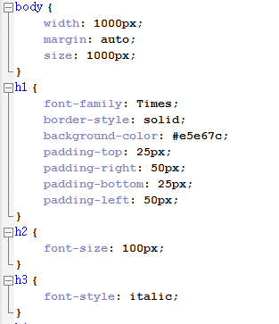

Slide 4
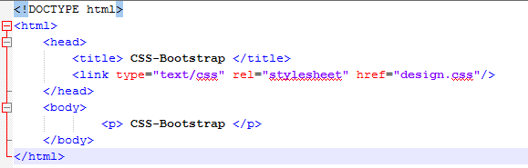
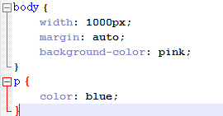
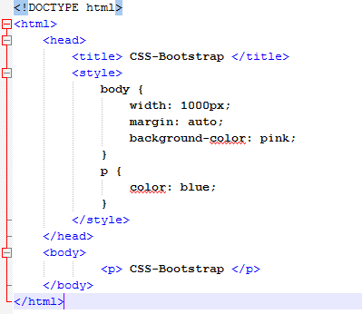
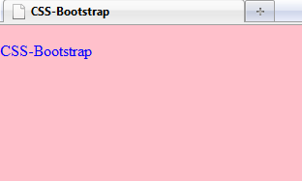
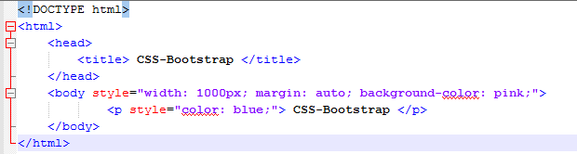
Ways to insert a style sheet
External style sheet
Internal style sheet
Inline styles

Slide 5
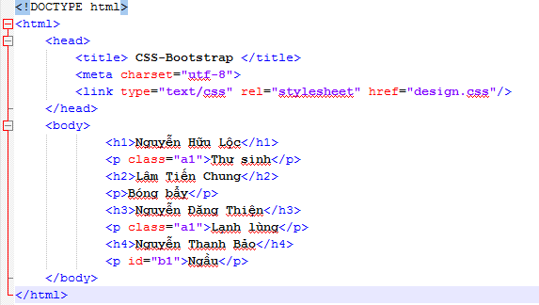
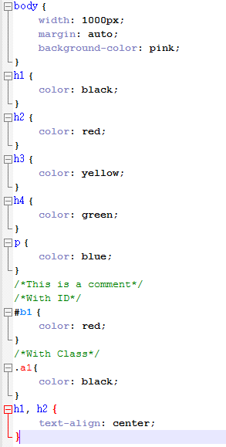
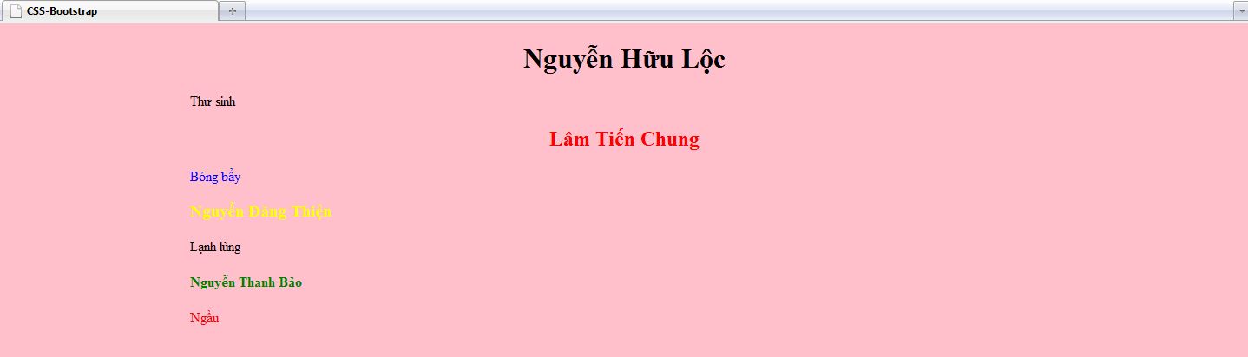

Slide 7
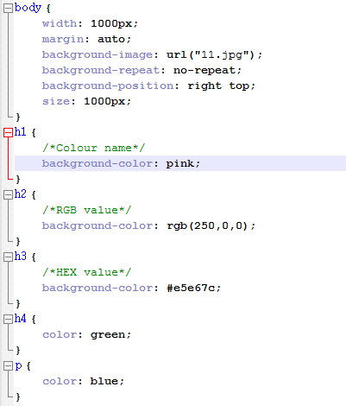
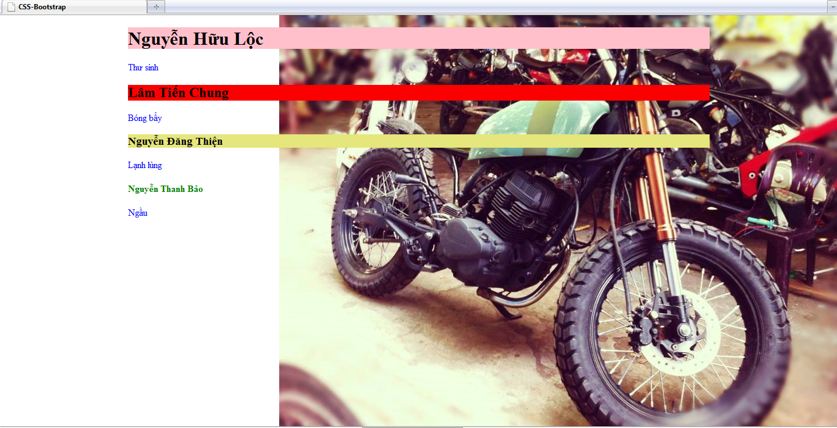

Slide 8
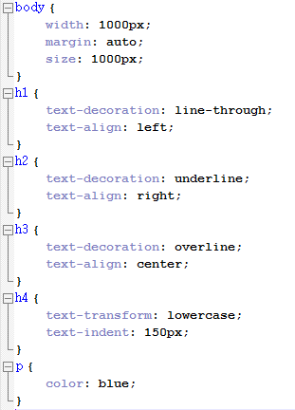
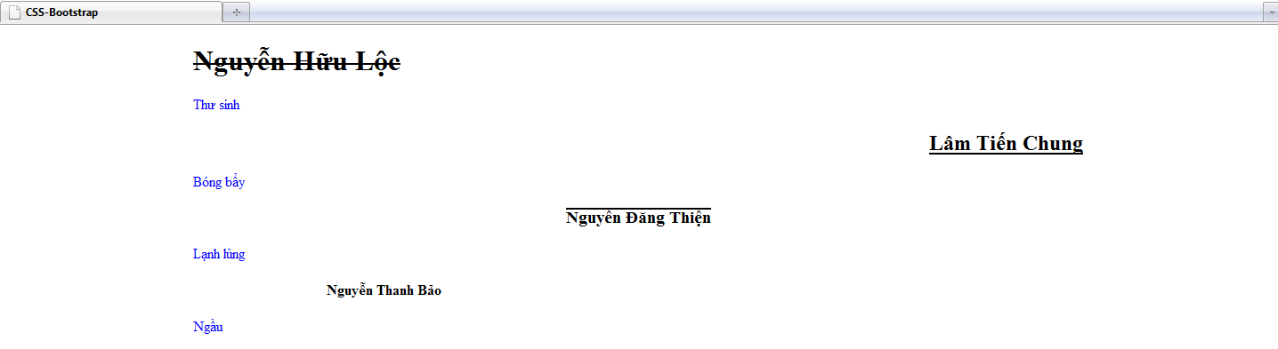

Slide 9
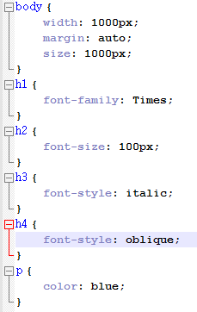
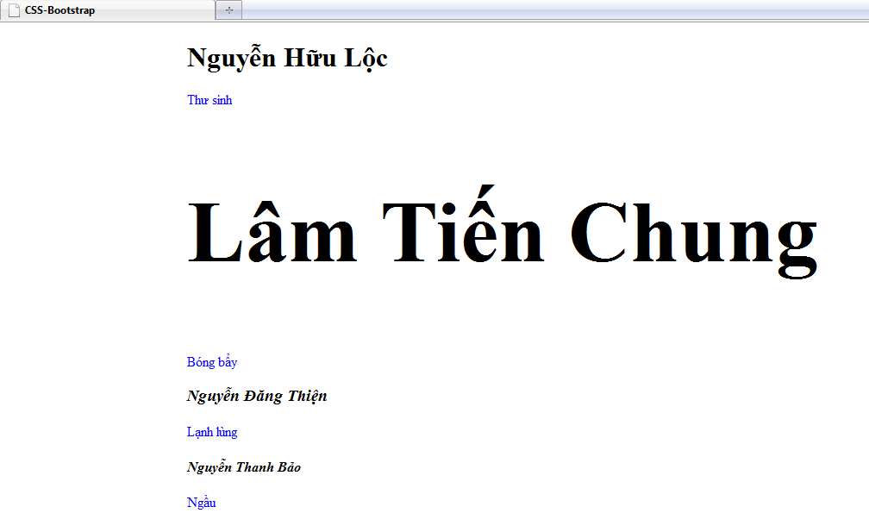

Slide 10
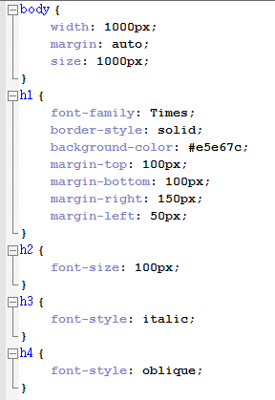
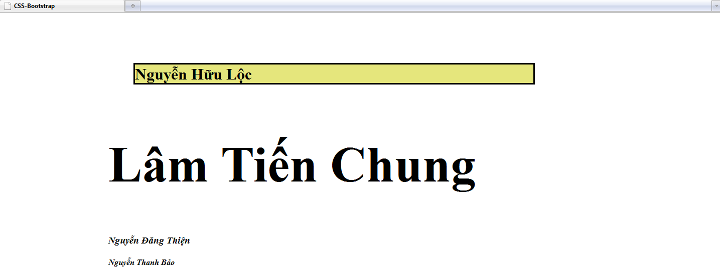

Slide 11
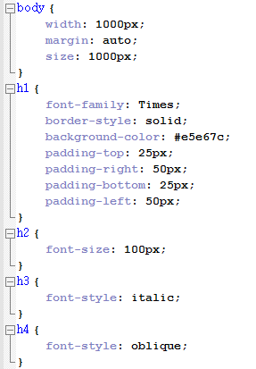
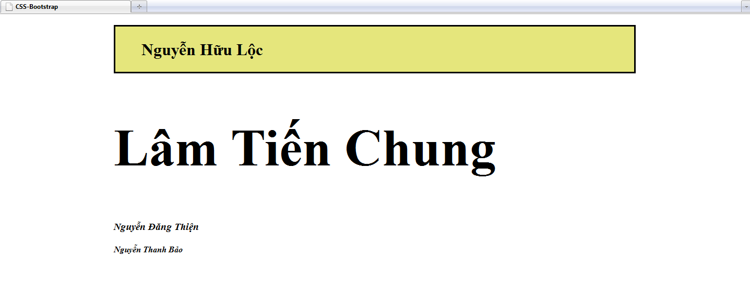

Slide 12
CSS3 (Cascading Style Sheets 3)

Slide 13
What is CSS3?
CSS3 is the latest standard for CSS
CSS3 is completely backward-compatible with earlier versions of CSS
Something's new in CSS3: CSS Borders, Backgrounds, Gradients, Text Effects, Fonts, 2D/3D Transformations, Transitions, Animations, Multiple Columns, User Interface
Notes:
Latest standard : tiêu chuẩn mới nhất
Backward-compatible : tương thích ngược

Slide 14
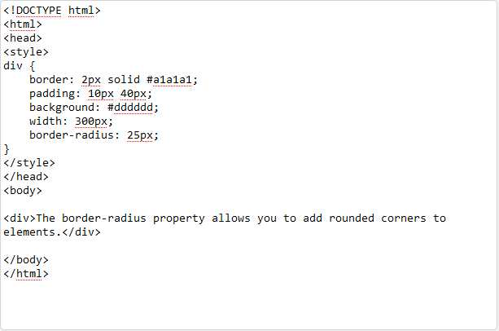

CSS3 Borders
1.Border-radius Property(Bo viền)

Slide 15
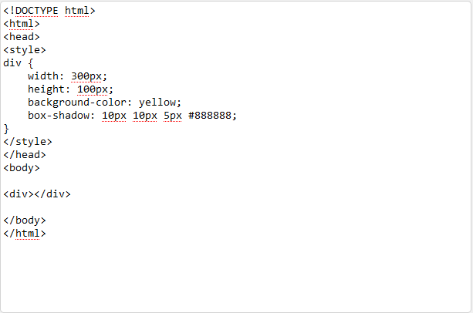

CSS3 Borders
2.Box-shadow Property(Bo viền): Use to add shadow to boxes

Slide 16
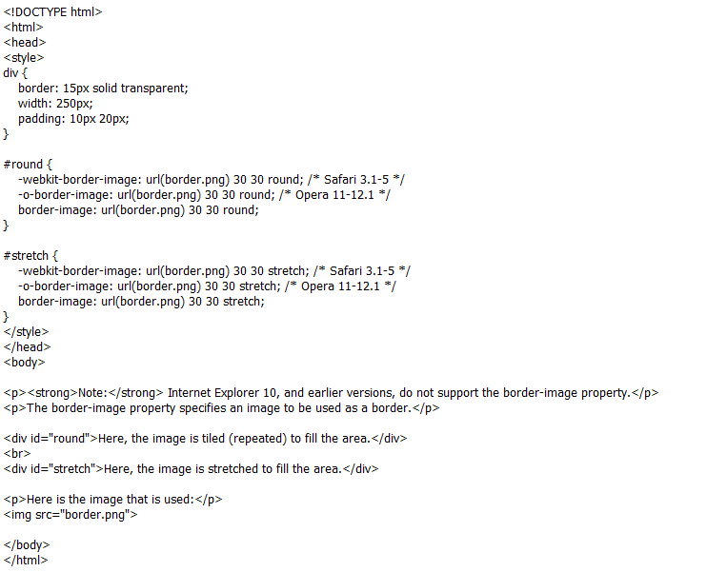
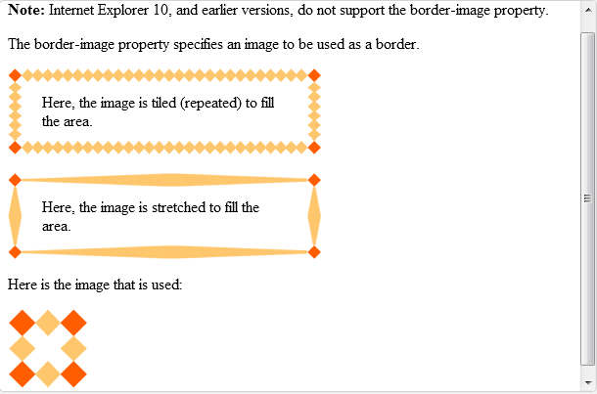
CSS3 Borders
3.Border-image Property(Bo viền hình ảnh): Use image to create border

Slide 17
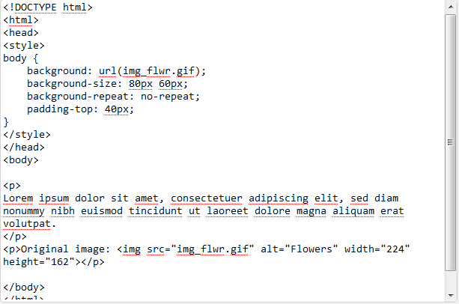
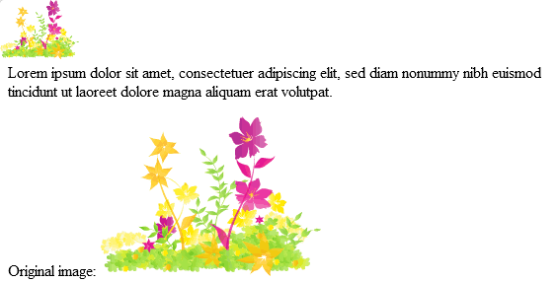
CSS3 Background
1.Background-size:
+ Specifies the size of the background image
+ Re-use background images in different contexts
+ Can specify in pixel or percentage

Slide 18
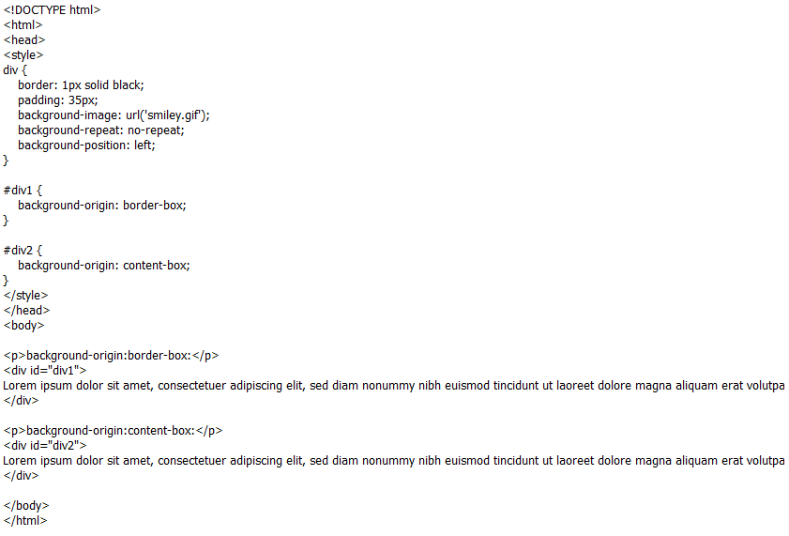
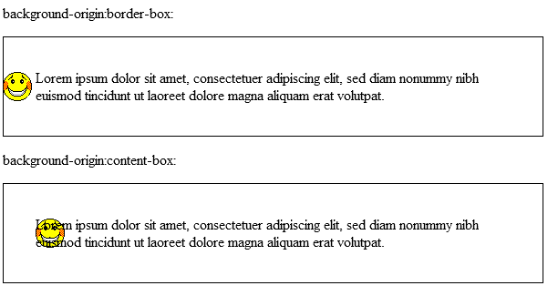
CSS3 Background
2.Background-origin:
+ Can be placed within the content-box, padding-box, or border-box data

Slide 19
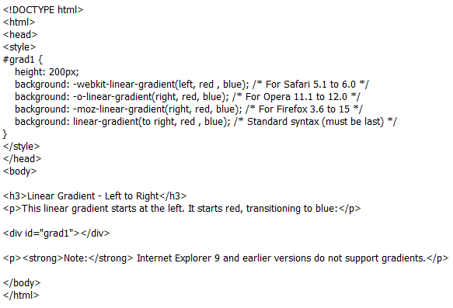
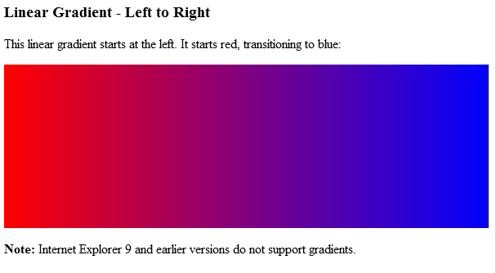
CSS3 Gradients
1.Linear Gradients(top-bottom,left-right,diagonal):
+Allow user to display smoothly transition between one or more certain of color
Notes:
Linear gradients (tuyến tính)

Slide 20
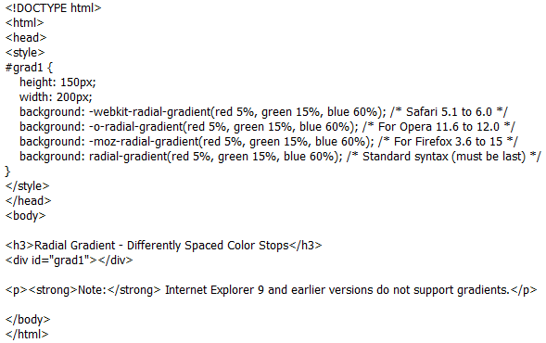
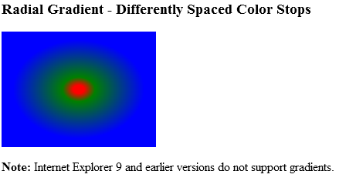
CSS3 Gradients
2.RadialGradients:
+Define by it center
+Define at least 2 colors stop
Notes:
Radial Gradients: xác định vị trí trung tâm

Slide 21
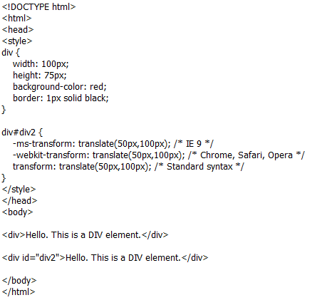
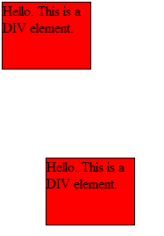
CSS3 2D Transforms:
1.Translate Method(dịch):
+Element moves from its current position, depending on parameter on left (X-axis) and top (Y-axis)

Slide 22
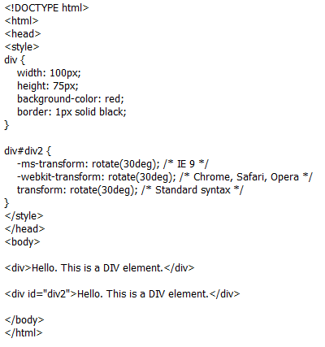
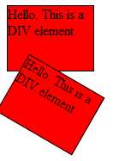
CSS3 2D Transforms:
2.Rotate Method(xoay):
+Rotate clockwise at a given degree. Negative values are allowed and rotates counter-clockwise

Slide 23
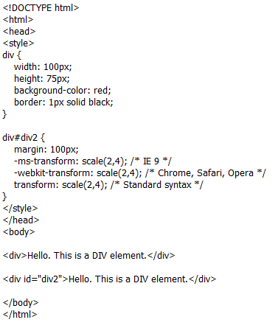
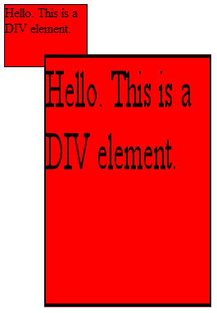
CSS3 2D Transforms:
3.Scale Method(qui mô):
+Increase and decrease size, depending on width (X-axis) and height (Y-axis)

Slide 24
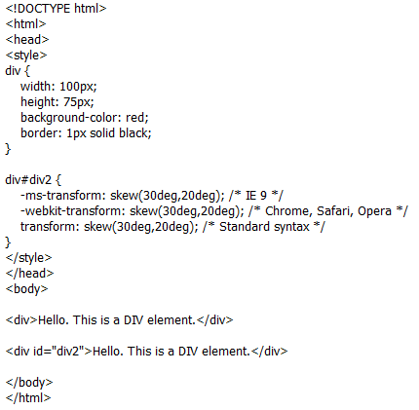
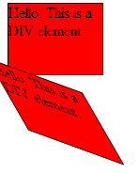
CSS3 2D Transforms:
4.Skew Method(nghiêng):
+Element turns in a given angle, depending on the parameters for the horizontal (X-axis) and vertical (Y-axis)

Slide 25
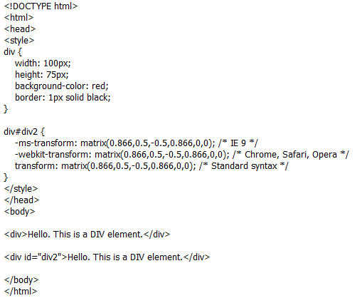
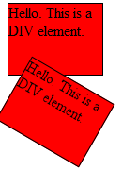
CSS3 2D Transforms:
5.Matrix Method(ma trận):
+ Combines all of the 2D transform methods into one.
+ Six parameters, allow user to : rotate, scale, translate, skew

Slide 26
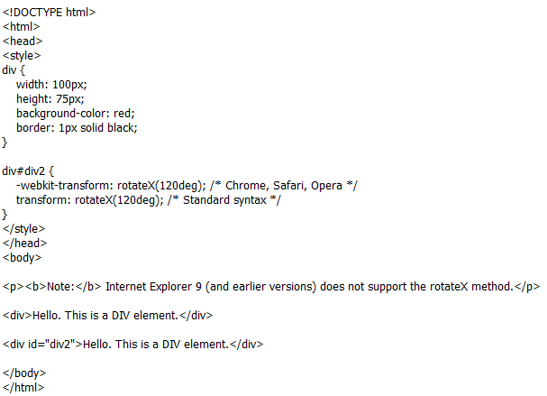
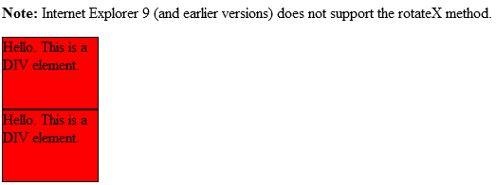
CSS3 3D Transforms:
1.RotateX Method:
+Element rotates around its X-axis at a given degree

Slide 27
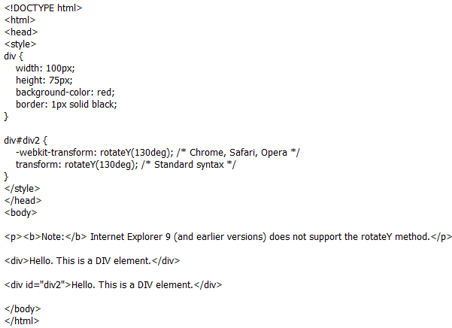
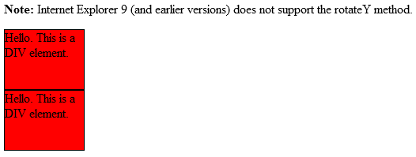
CSS3 3D Transforms:
2.RotateY Method:
+Element rotates around its X-axis at a given degree

Slide 28
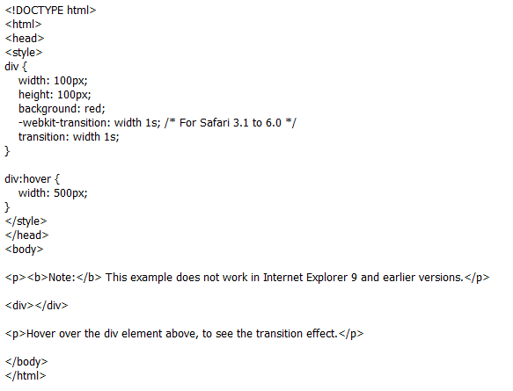
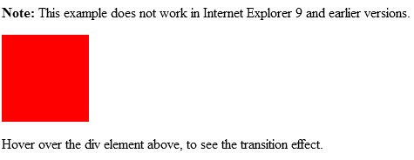
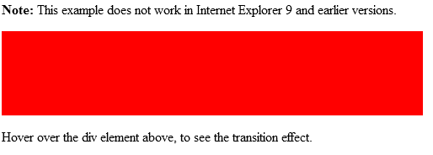
CSS3 Transition:

Slide 29



CSS3 Animations:

Slide 30
Bootstrap

Slide 31
What is Bootstrap
Bootstrap is a free collection of tools for creating websites and web applications
Bootstrap contains HTML and CSS-based design templates for text, forms, buttons, navigation and other components
Bootstrap also contains optional JavaScript extensions
Bootstrap is open source and available on GitHub

Slide 32
Bootstrap history
Bootstrap was developed by Mark Otto and Jacob Thornton at Twitter as a framework to encourage consistency across internal tools. Before Bootstrap, various libraries were used for interface development, which led to inconsistencies and a high maintenance burden.
Bootstrap was released as an open source product in August 2011 on GitHub.
In June 2014 Bootstrap was the No.1 project on GitHub!

Slide 33
Why use Bootstrap?
Mobile-first approach: Since Bootstrap 3, the framework consists of mobile-first styles throughout the entire library
Browser support: Bootstrap is supported by all popular browsers
Responsive web design: Bootstrap's responsive CSS adjusts to Desktops, Tablets, and Mobile phones
Easy to get started: With just the knowledge of HTML and CSS anyone can get started with Bootstrap

Slide 34
What does Bootstrap include?
Scaffolding: Contains layout, grid system, fluid grid system, and responsive design
Base CSS: Contains classes for typography, tables, forms, buttons, images, and more
Components: Contains reusable components: icons, dropdowns, navbars, breadcrumbs, alerts, and more
JavaScript Plugins: Contains over a dozen custom jQuery plugins. You can include them all, or one by one
Customizable Components : Customize Bootstrap's components, LESS variables, and jQuery plugins to create your own version

Slide 35



Slide 36


Slide 37



Slide 38



Slide 39






Slide 40


Notes:
Jumbotron

Slide 41
Thanks for listening
Reference: www.w3schools.com

